Slide 1




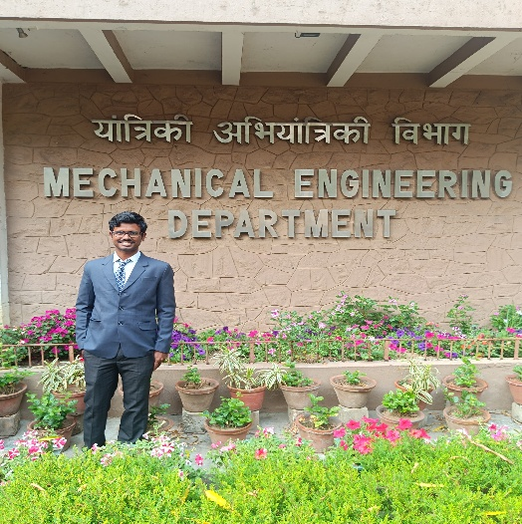
Topic: integrated carbon capture and conversion process to synthetic natural gas
Team Name: DEEPWATER HORIZON
Arghadeep Biswas
Fourth Year(Dual Degree),
Chemical Engineering,
IIT Kharagpur
Rahul Rajwar
Fourth Year(Dual Degree),
Chemical Engineering,
IIT Kharagpur
Debojyoti Roy
Fourth Year(Btech),
Mechanical Engineering,
IIT Kharagpur

Slide 2
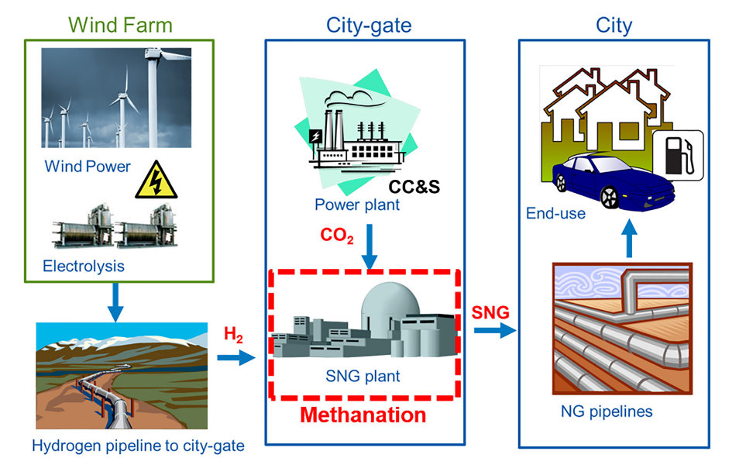
Introduction
Power-to-Gas Technology(PTG)
Methanation has been a common practise for eliminating CO and CO₂ in various chemical processes
PTG technologies convert renewable electricity and carbon feedstocks into valuable products like liquid fuels, hydrogen, methane (SNG), methanol, and ethylene
Power-to-Gas (P2G) helps store extra renewable energy and can balance the power grid at a low cost, making it easier to use more solar and wind power
Most CO₂ methanation plants today are small-scale, except for Audi’s 6 MW e-gas plant. None use fuel cell or electrolysis technologies yet.
Fig. 1 : Hydrogen from wind-powered electrolysis to SNG production architecture(Becker et al)

Slide 3
Bridging the Gap
Research Gap: Limited region-specific studies on CCUS-PtG for India’s emission-heavy sectors (e.g., cement, refining).
Opportunity: IOCL’s large refineries offer ideal sites to pilot CO₂ conversion using green hydrogen (renewable energy).
Focus: Techno-economic feasibility of CCUS-PtG to:
Cut industrial CO₂ emissions,
Store renewable energy,
Enable sector coupling in India’s energy transition.
Goal: Develop a framework for scalable deployment aligned with India’s climate targets.

Slide 4
Problem statement
Goal: To address the dual challenge of reducing carbon emissions and meeting the global demand for cleaner fuels
Carbon Capture Model Harnesses advanced technology to isolate pure CO₂ from industrial emission
Water Electrolysis Model Generate high-purity H₂ using renewable electricity, ensuring green hydrogen supply
Integrated Conversion Process Combines the Reverse Water-Gas Shift Reaction and Fischer Tropsch Synthesis (FTS) to efficiently convert CO₂ and H₂ into a broad range of hydrocarbons with methane as the primary focus(CO₂ methanation)

Slide 5
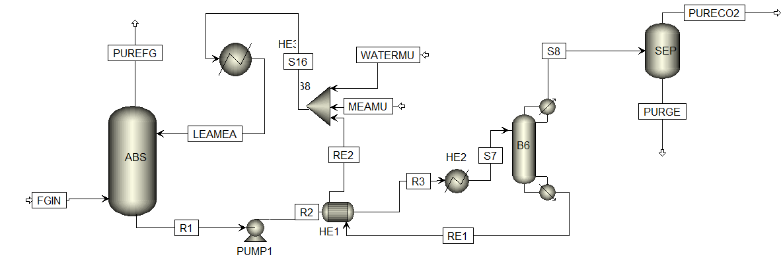

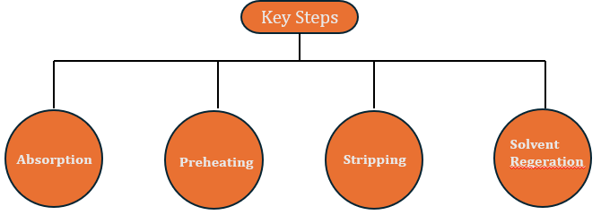
Innovation Content
Carbon Capture Model
Rad-Frac based
Model
Mono-ethanol amine used as lean solvent
Fig. 2 : MEA based carbon capture model in Aspen Plus(TRL 9)
Inspired from CO₂ Capture by Reactive Absorption-Stripping Modeling, Analysis and Design by Madeddu et al.

Slide 6
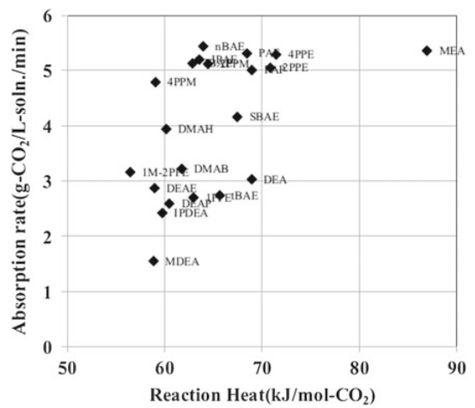
Innovation Content
Why Choose MEA for CO₂ Capture?
RITE Japan studied hundreds of amine solutions to identify those with high CO₂ loading, fast absorption rates, and low heat of absorption.
Structure–performance relationships were analyzed using experiments and computational chemistry to design better solvents.
Key challenges like amine degradation, by-product formation, and corrosion were addressed with solvent reclaiming and additives — MEA remains a benchmark for performance and simplicity
Fig 3: Relation Between absorption heat and absorption rate
Advanced CO₂ Capture Technologies Absorption, Adsorption, and Membrane Seperation Methods by Shin-ichi Nakao

Slide 7
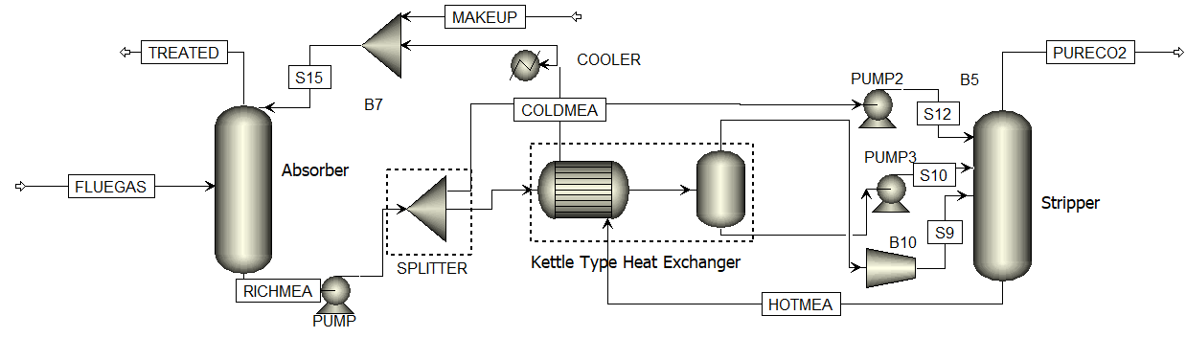
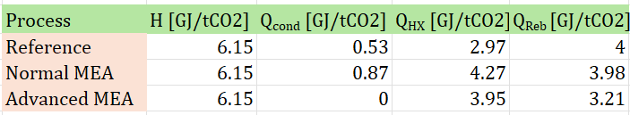
Innovation Content
Major Problems with traditional MEA solvent technique
Reboiler is the most energy intensive unit
Difficult to eliminate condenser cooling duty with enough preheating
Almost 20 % reduction in Reboiler Duty!
Fig. 4 : MEA based carbon capture model in Aspen Plus
Split cold solvent cools the top of the stripper
Reflux flow and condenser cooling are eliminated
Reduces the heat exchanger preheating duty

Slide 8
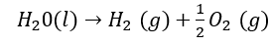
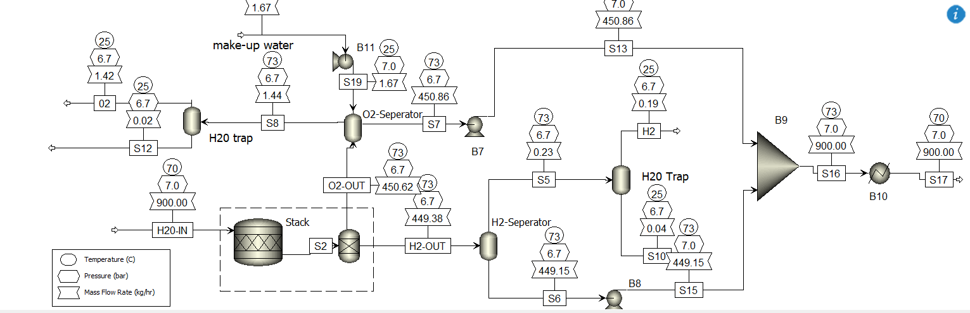
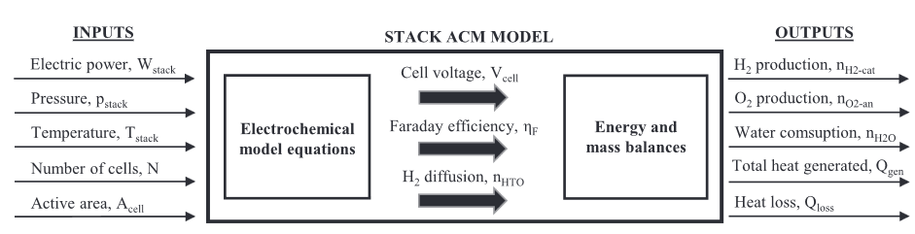
Innovation Content
Water Electrolysis Model
Takes place in cell stack
Hydrogen production is computed with
$$n\left(H2\right)=\frac{P(Stack)}{V\left(Cell\right).z.F}$$
The power requirement is calculated as follows
$$P\left(Stack\right)=V\left(cell\right).N.I$$
V(Cell) : Cell voltage (V)
N: Number of cells of the stack
I: Current (A)
Fig 5: Aspen Plus flowsheet of water electrolysis process(TRL4)
Adapted from Aspen Plus model of an alkaline electrolysis system for H₂ production, Sanchez et al.
Fig 6: Operation unit developed in Aspen Custom Modeler for modelling the tank

Slide 9
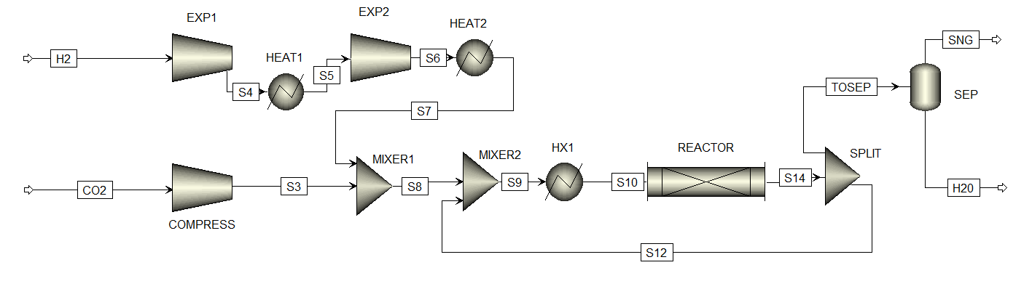
Innovation Content
CO₂ Methanation Model
Fig 7: Process flow diagram of CO₂ methanation
Feed Handling & Reaction: CO₂ and H₂ (4:1 ratio) are pressure-adjusted and mixed before entering a single adiabatic reactor using a 0.5 wt% Ru/Al₂O₃ catalyst.
Energy Integration: A turbo-expander decompresses high-pressure H₂, recovering energy, while 60% product recirculation helps stabilize reactor temperature.
Product Quality & Output: After synthesis and water removal, the CH₄-rich gas achieves >96 mol% purity suitable for grid injection, with a system output of 148 MW.

Slide 10
Technology / Process / Product
PtG Plant Process Flow Diagram
Synthesis section
Electrolysis section
Utilities
CC section

Slide 11
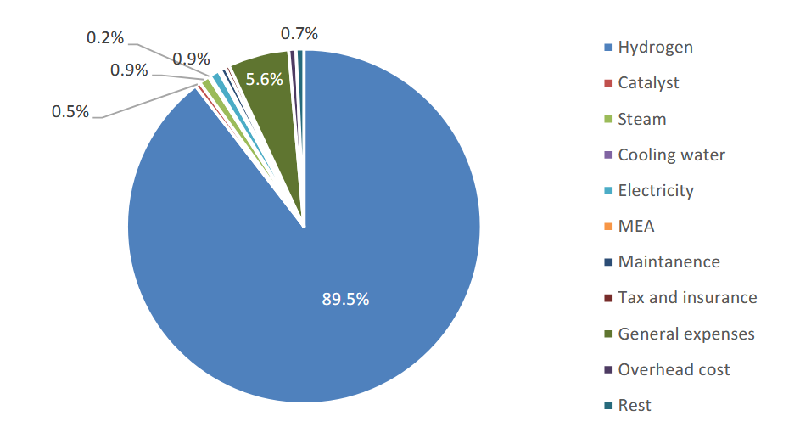
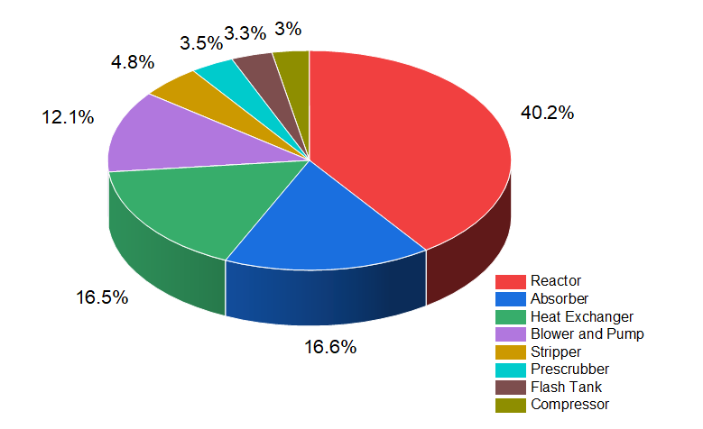

ECONOMIC VIABILITY
Fig 8: Breakdown of OPEX
Fig 9: Breakdown of PEC
CAPEX – 21.3 M$
OPEX – 35.4 M$
The expected purchase equipment cost was
$22 million

Slide 12
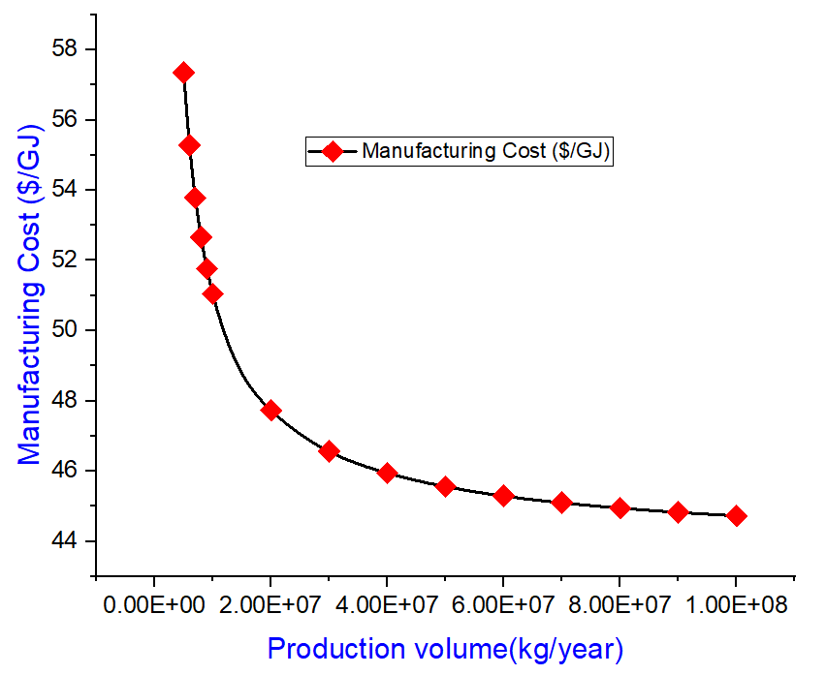
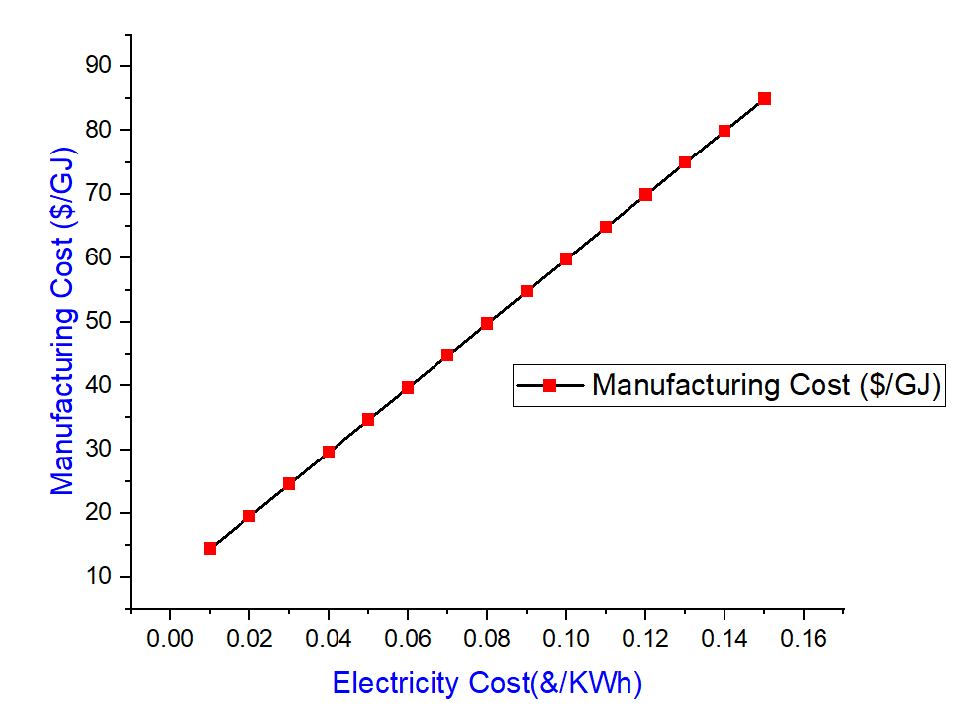
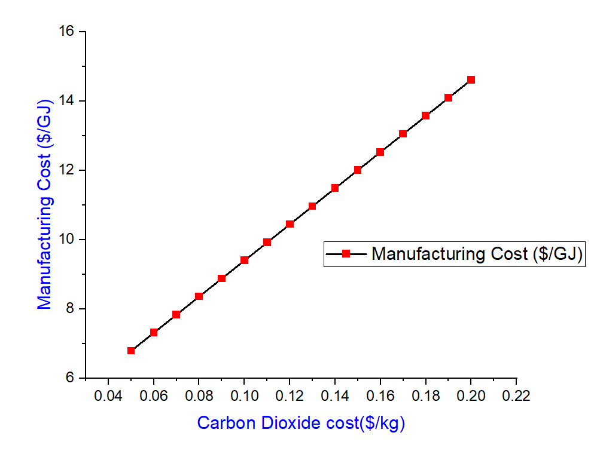
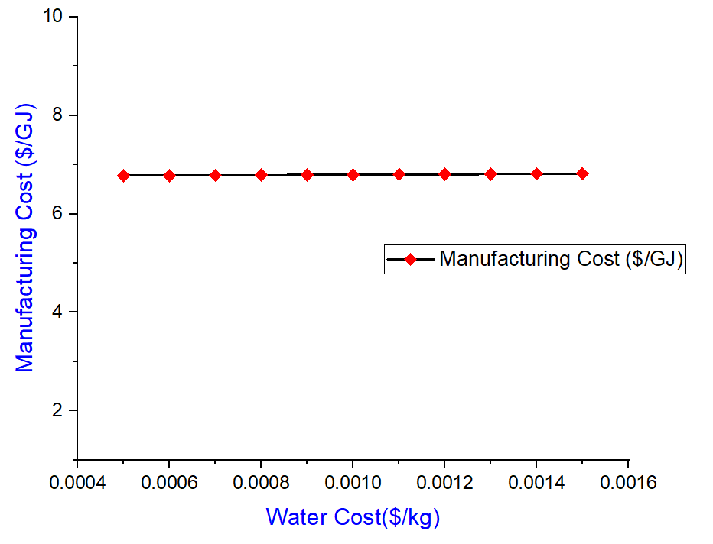
ECONOMIC VIABILITY
Sensitivity Analysis
Uncertainty Analysis

Slide 13
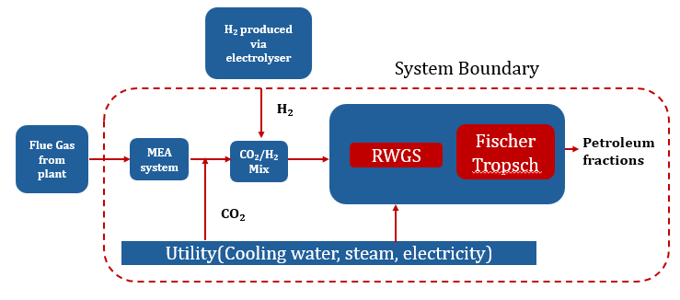
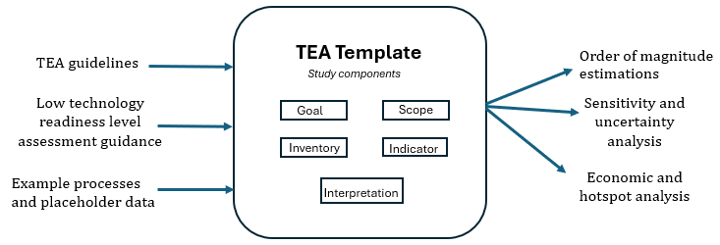
Proposal
Objective: Deploy an integrated CO₂ hydrogenation pilot plant for SNG(Synthetic Natural Gas) production using captured CO₂ and hydrogen produced from electrolysis
Technology Stack:
MEA-based CO₂ Capture (TRL 9, optimized for low reboiler duty)
Alkaline Water Electrolysis (integrated model for 99.5% H₂ purity)
RWGS + Fischer-Tropsch Methanation (Ru-based catalyst, methane-rich syngas)
Fig 10: System elements and boundaries of the studied methanation process
Fig 11: TEA Template methodology for methanation process

Slide 14
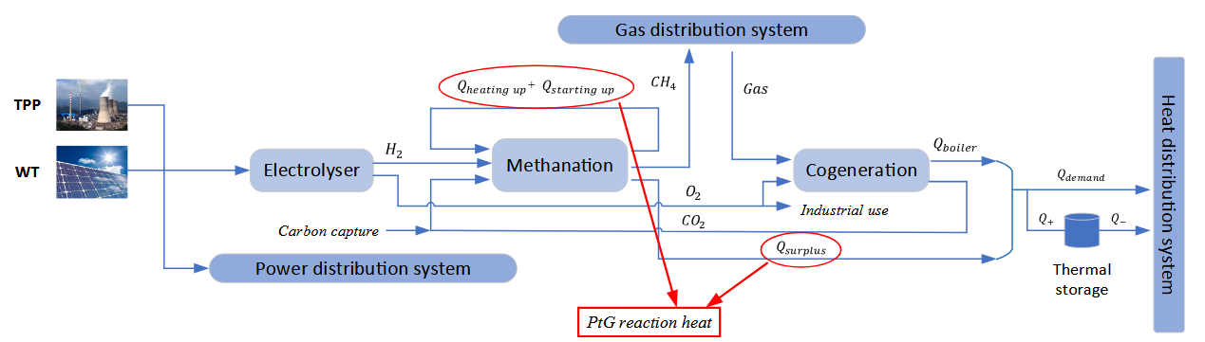
Action Plan
Synthetic Natural Gas is quite expensive!
PtG operates independently, which limits it’s profitability
1.
Wind Turbines
PtG
Cooperative Union(Game-Theory based)
Electric grid
Heat
Fig 12: Energy conversion effect of PtG in integrated energy system (Li et al)
2.
Utilization of PtG By-products (Heat + Oxygen)
PtG produces more than just methane:
Oxygen (from electrolysis) can be sold for revenue.
Heat (from the exothermic methanation reaction) is usually wasted.
Game-Theoretic Union:
A union of multiple agents (PtG, Grid, WT, Heat) is formed.
Each agent must benefit more inside the union than they would outside it.
Shapley Value ensures:
Individual rationality (no one loses),
Group rationality (total union profit > sum of individual profits).
3.
Symbiosis Cooperation Mode (RPSCM) for Peer-to-Peer (P2P) Trade
Traditional PtG systems buy electricity from the market, often at high prices.
Instead, proposing a symbiotic model, where:
a) Wind power is directly supplied to PtG (bypassing the market).
b) Surplus energy is sold to the grid only when needed.

Slide 15
Action Plan
Scale to 10-20 MW multi-unit PtX clusters
Launch RE-PtG Symbiosis Cooperation Model (RPSCM)
Integrate PtG reaction heat into local heating system
Deploy 100+ MW PtX systems in PSU clusters
Inject SNG into gas grids at scale
Build India’s position in global SNG trade
Identify high CO₂-emission sites (e.g., IOCL, NTPC)
Simulate PtG models
Analyze by-product recovery (heat, O₂)
Pilot
Deployment
Policy & Market Integration
2026
2029-
30
2025
2027-28
2031-
35
Tech
Validation
Deploy 1–5 MW CO₂-to-SNG plant with green H₂
Test cooperative union model (RE, Grid, Heat, PtG)
Evaluate profit-sharing using Shapley Value
Implement carbon pricing & synthetic fuel incentives
Enable P2P energy trading and virtual power plants
Certify green fuels for grid and industrial blending
Regional
Demonstration
National Rollout & Export

Slide 16
Envisaged Benefits to Oil PSUs / IOCL / Societal Impact
Operational & Infrastructure Benefits
Captures CO₂ from existing units (SMRs, reformers, steel plants) → SNG production without major retrofits
Grid-ready methane (>96% CH₄) can be injected into IOCL’s existing pipelines — no new distribution infra needed
Energy Integration & Resource Efficiency
Utilizes surplus renewable power to produce green H₂ for methanation (aligned with National Green Hydrogen Mission)
Enables power-to-gas energy storage → addresses solar/wind intermittency
Economic & Feasibility Insights
At ₹6.7/MJ, SNG is costlier than imported NG (₹4/MJ) but enables CO₂ abatement at ₹67/kg—offering a strategic decarbonization path aligned with India’s climate goals
Sensitivity: Electricity price is key driver → critical insight for pilot siting and power sourcing

Slide 17
Thank you !

Slide 18
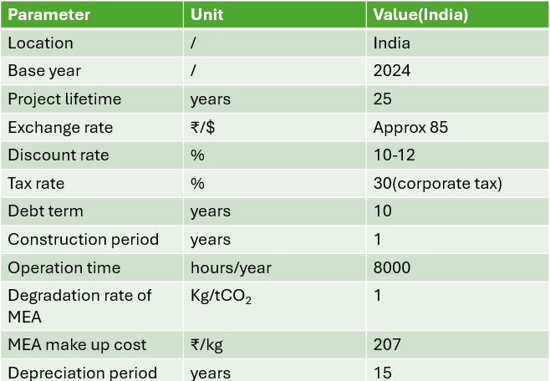
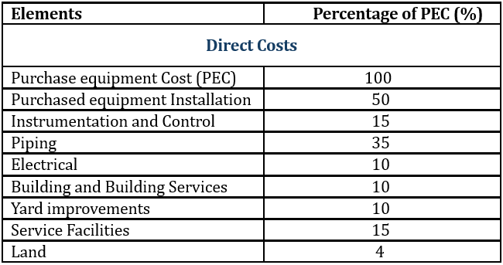
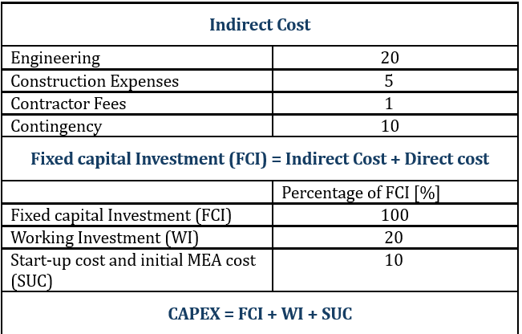
ECONOMIC VIABILITY
Capital Expenditure
Since no commercial-scale-coal-to-SNG project has been reported operating in India, the reference cost of benchmark is taken from a study based in the US.

Slide 19
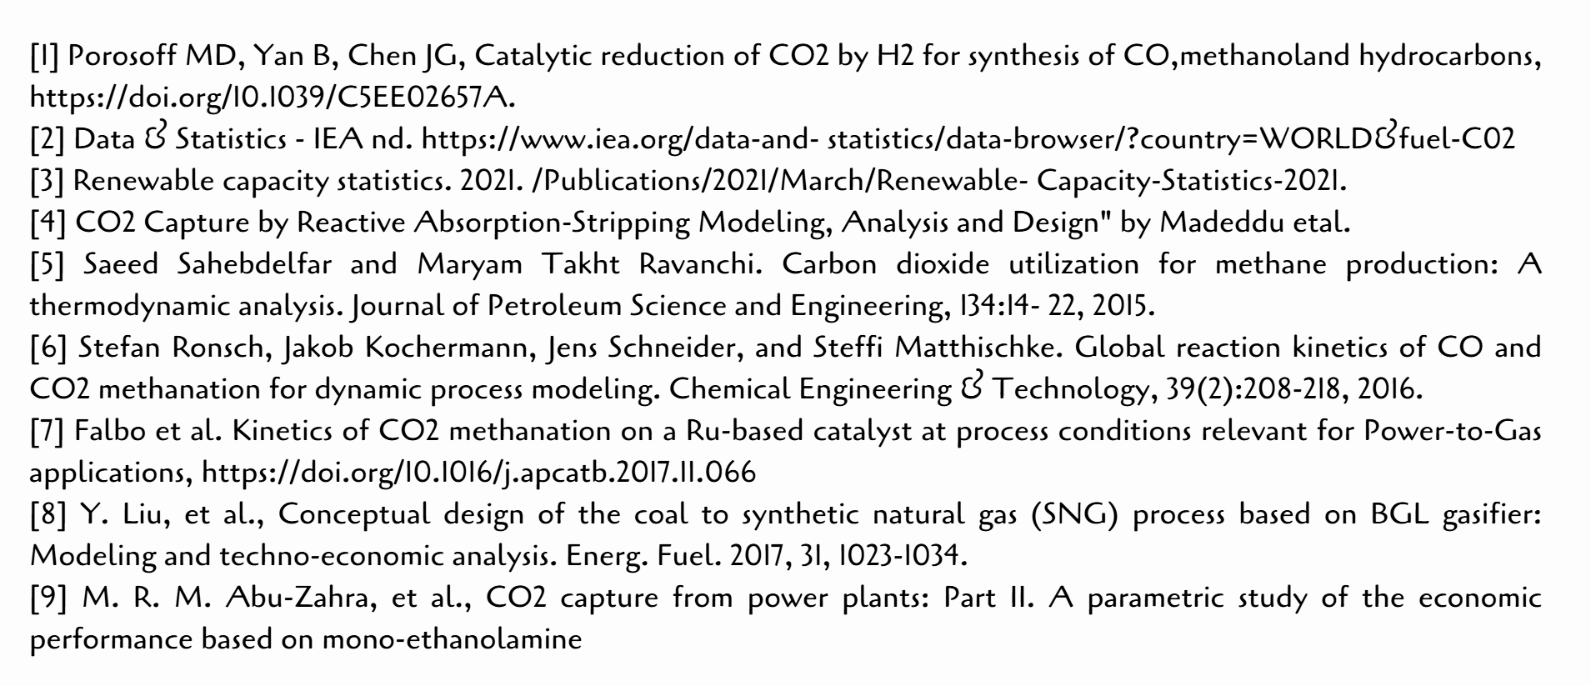
References

Slide 20
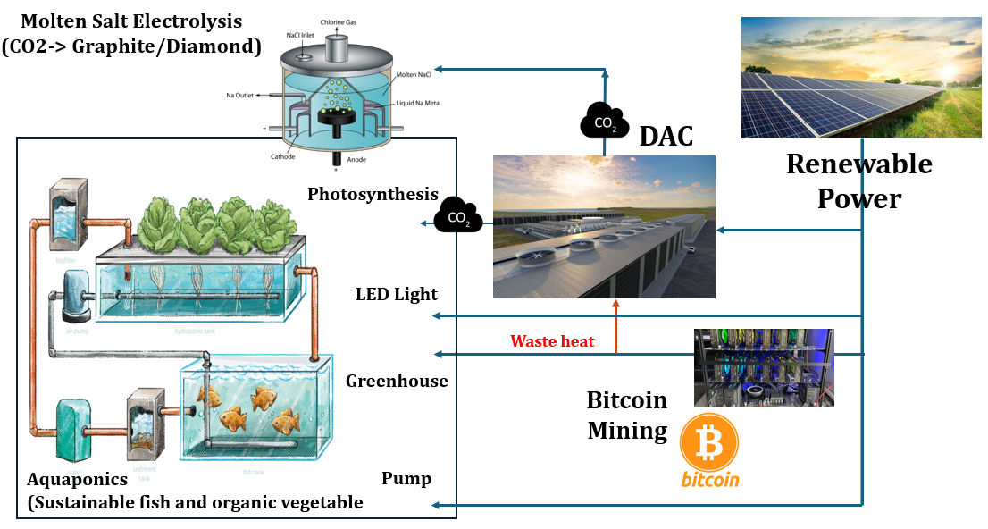

Current Projects

Slide 21
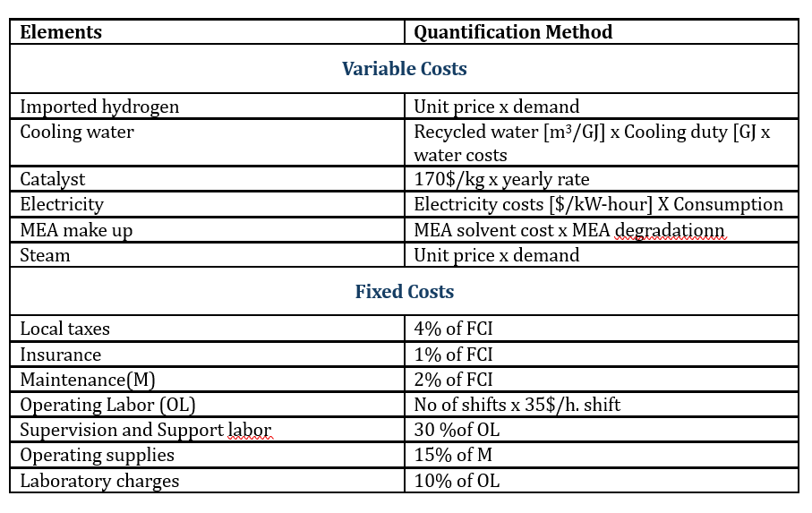
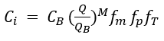
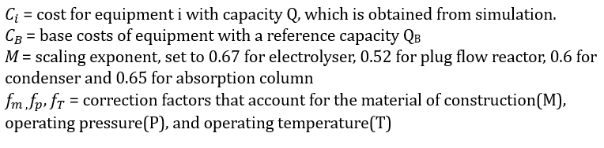
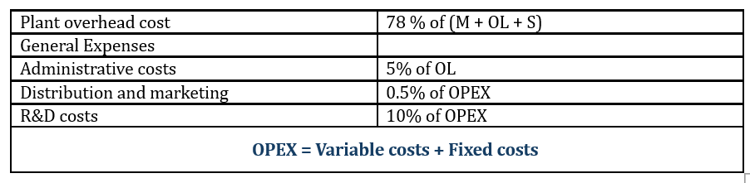
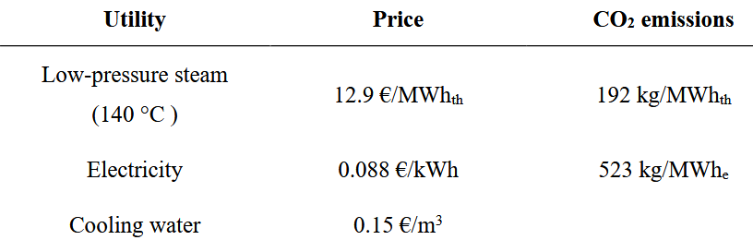
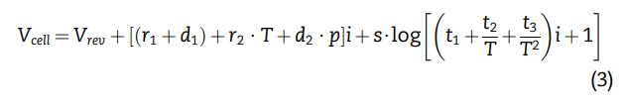
Appendix
Purchase Equipment Cost
Our Excel Sheet Link - http://surl.li/ffsiwr
For absorber and stripper, equipment costs are calculated

Slide 22
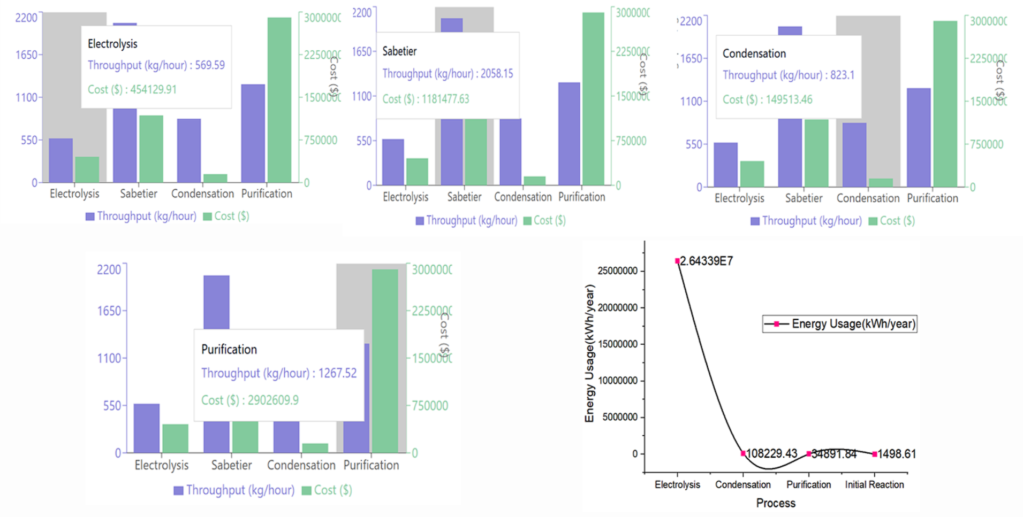
Appendix

Slide 23
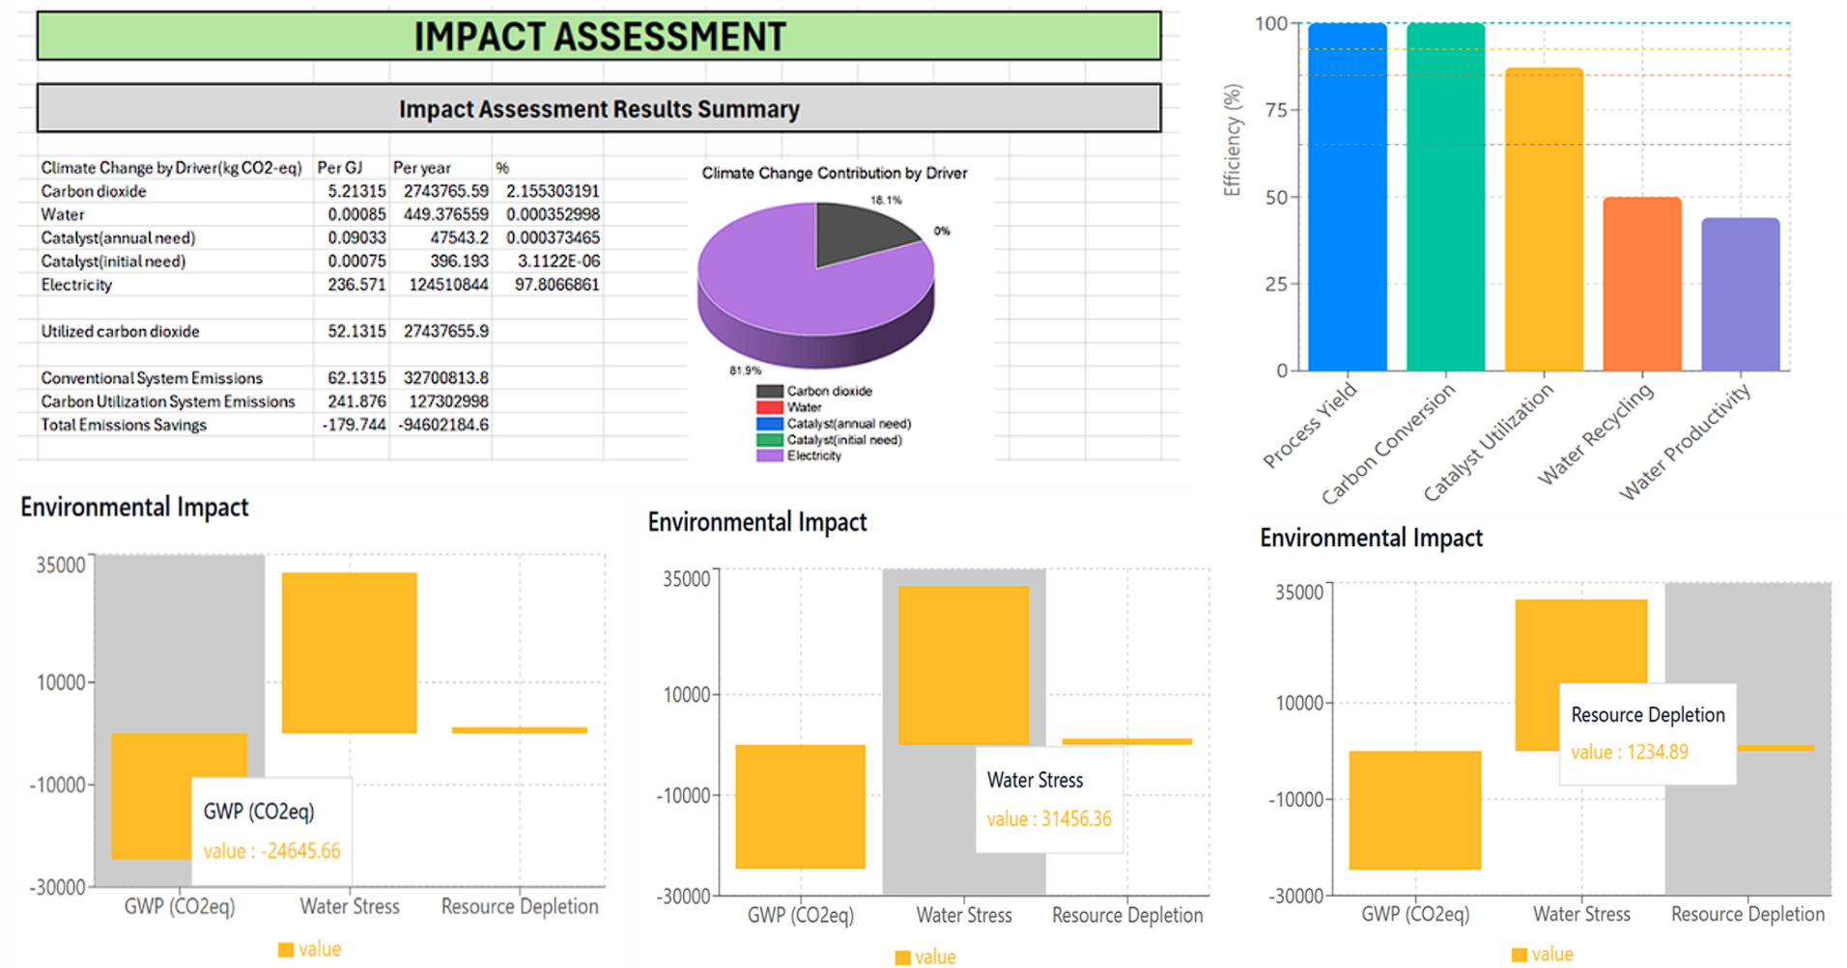
Appendix

